Slide 1
Chapter 5
How to use the CSS box model for spacing, borders, and backgrounds

Slide 2
Objectives
Applied
Given an HTML document, create CSS style rules that use the CSS box model to apply spacing, borders, and backgrounds.
Knowledge
Describe the use of the CSS box model.
Explain how the CSS box model can be used to control the spacing between the headings and paragraphs on a page.
Describe the effect of “collapsed margins”.
Describe these properties for a block element in a box model: height, width, margin, padding, border, background color, and background image.
Describe these CSS3 features for formatting boxes: rounded corners, shadows, background gradients.

Slide 3
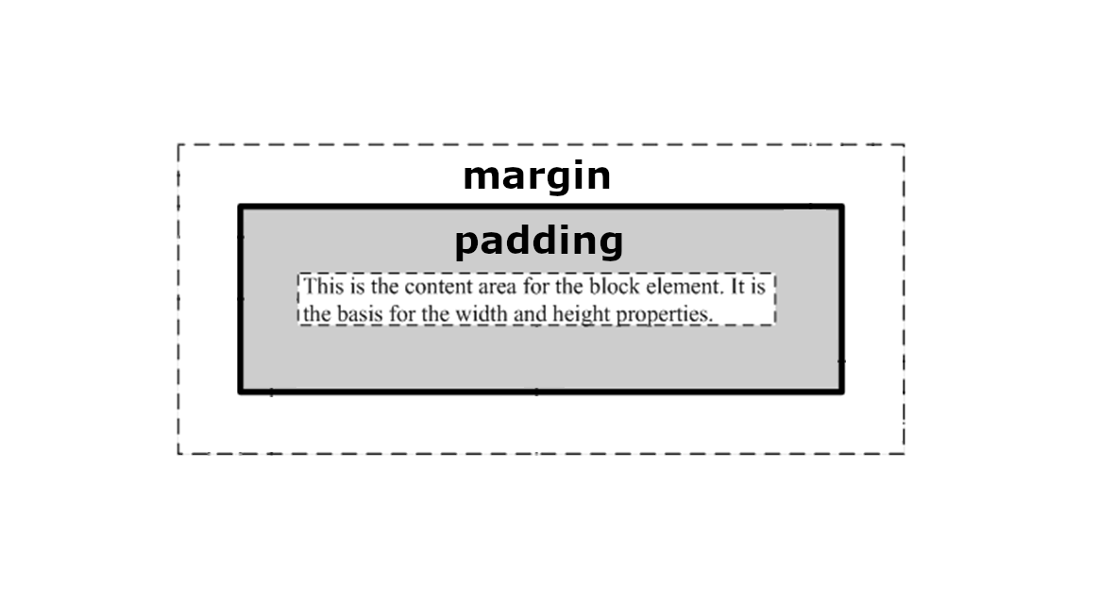
The CSS box model

Slide 4
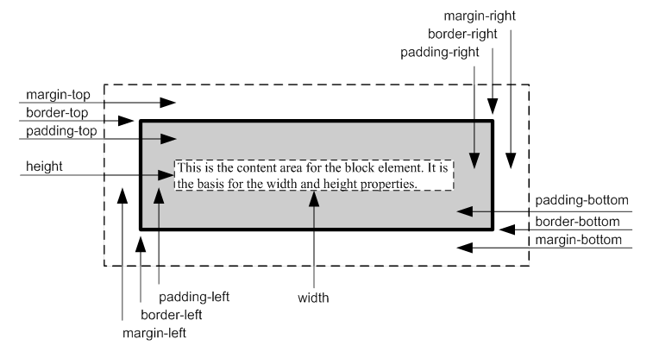
The CSS box model

Slide 5
The formula for calculating the height of a box
height
The formula for calculating the width of a box
width
BY DEFAULT, MARGIN, BORDER, AND PADDING ARE NOT INCLUDED IN THE WIDTH AND HEIGHT CALCULATIONS

Slide 6
CSS box-sizing
box-sizing: content-box;
“content-box gives you the default CSS box-sizing behavior. If you set an element's width to 100 pixels, then the element's content box will be 100 pixels wide, and the width of any border or padding will be added to the final rendered width.”
More Information
https://developer.mozilla.org/en-US/docs/Web/CSS/box-sizing

Slide 7
CSS box-sizing
box-sizing: border-box;
“border-box tells the browser to account for any border and padding in the values you specify for an element's width and height. If you set an element's width to 100 pixels, that 100 pixels will include any border or padding you added, and the content box will shrink to absorb that extra width. This typically makes it much easier to size elements.”
More Information
https://developer.mozilla.org/en-US/docs/Web/CSS/box-sizing

Slide 8
The HTML for a page that uses the box model
<body>
<main>
<h1>San Joaquin Valley Town Hall</h1>
<p>Welcome to San Joaquin Valley Town Hall.
We have some fascinating speakers for you this
season!</p>
</main>
</body>
book_examples/ch05/02_box_model.html

Slide 9
The CSS for a page that uses the box model
body {
border: 3px dotted black;
margin: 10px;
}
main {
border: 2px solid black;
width: 500px;
margin: 20px;
padding: 10px;
}
h1, p {
border: 1px dashed black;
padding: 10px;
}
h1 {
margin: .5em 0 .25em 0;
padding-left: 15px;
}
p {
margin: 0;
padding-left: 15px;
}
book_examples/ch05/02_box_model.html

Slide 10
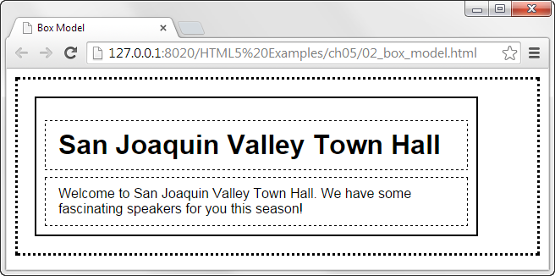
The web page in a browser
book_examples/ch05/02_box_model.html

Slide 11
How to set the width of the content area
width: 450px; /* an absolute width */
width: 75%; /* a relative width */
width: auto; /* width based on content (default) */
How to set the height of the content area
height: 125px;
height: 50%;
height: auto; /* height based on content (default) */
How to set the minimum and maximum width and height
min-width: 450px;
max-width: 600px;
min-height: 120px;
max-height: 160px;

Slide 12
How to set the margin on a single side
margin-top: .5em;
margin-right: 1em;
margin-bottom: 2em;
margin-left: 1em;
How to set the margins on multiple sides
margin: 1em; /* all four sides */
margin: 0 1em; /* vertical, horizontal */
margin: .5em 1em 2em; /* top, right and left,
bottom */
margin: .5em 1em 2em 1em; /* top, right, bottom, left */

Slide 13
How to set the padding on a single side
padding-top: 0;
padding-right: 1em;
padding-bottom: .5em;
padding-left: 1em;
How to set the padding on multiple sides
padding: 1em; /* all four sides */
padding: 0 1em; /* vertical, horizontal */
padding: 0 1em .5em; /* top, right and left, bottom */
padding: 0 1em .5em 1em; /* top, right, bottom, left */

Slide 14
Recommended Practices
Use the following units for the listed purposes.
px
border, outline
rem
margin, padding, width, height
vh
height, min-height, max-height
vw
width, min-width, max-width

Slide 15

A web page with widths, margins, and padding
book_apps/ch05/town_hall/index1.html

Slide 16
The box model styles for the web page
body {
width: 700px;
margin: 1em auto;
}
h1, h2, h3, p {
margin: 0;
padding: 0;
}
ul { margin: 0 0 1.5em; }
li { padding-bottom: .35em; }
p { padding: .25em 0; }
book_apps/ch05/town_hall/styles/main1.css

Slide 17
The box model styles (continued)
/* the styles for the header */
header h2 { margin-bottom: .25em; }
/* the styles for the main content */
main h1 { margin: 1em 0 .35em; }
#contact_us { margin-top: 1em; }
/* the styles for the footer */
footer { margin-top: 1em; }
book_apps/ch05/town_hall/styles/main1.css

Slide 18
A web page with widths, margins, and padding
book_apps/ch05/town_hall/index1.html

Slide 19

A version of the page that uses a reset selector
book_apps/ch05/town_hall/index2.html

Slide 20
The changed box model styles for the page
* {
margin: 0;
padding: 0;
}
ul { margin: 0 0 1.5em 1.25em; }
li {
font-size: 95%;
padding-bottom: .35em;
padding-left: .25em;
}
#contact_us { margin-top: 1em; }
Use normalize.css instead of a universal css reset.
Universal css reset rules create more problems than they solve and are not a recommended practice!

Slide 21
Properties for setting borders
border
border-side
border-width
border-style
border-color
border-side-width
border-side-style
border-side-color
The syntax for the shorthand border and border-side properties
border: [width] [style] [color];
border-side: [width] [style] [color];

Slide 22
How to set border properties
border: thin solid green;
border: 2px dashed #808080;
border: 1px inset; /* uses the element's color property */
How to set side borders
border-top: 2px solid black;
border-right: 4px double blue;

Slide 23
How to set the widths of borders
border-width: 1px; /* all four sides */
border-width: 1px 2px; /* top and bottom, right and left */
border-width: 1px 2px 2px; /* top, right and left, bottom */
border-width: 1px 2px 2px 3px; /* top, right, bottom, left */
How to set the style of borders
border-style: dashed; /* dashed line all sides */
border-style: solid none; /* solid top and bottom, no border right and left */
How to set the color of borders
border-color: #808080;
border-color: black gray; /* black top and bottom, gray right and left */
How to set the width, style, and color
border-bottom-width: 4px;
border-right-style: dashed;
border-left-color: gray;

Slide 24
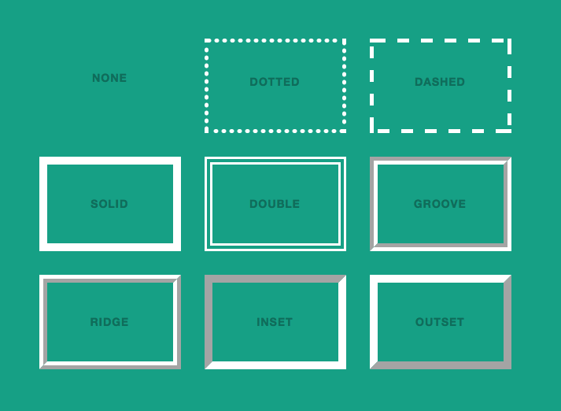
Border Styles
https://tympanus.net/codrops/css_reference/border-style/

Slide 25
The syntax for the border-radius and box-shadow properties
border-radius: radius; /* applies to all four corners */
border-radius: topLeft topRight lowerRight lowerLeft;
box-shadow: horizontalOffset verticalOffset blurRadius spread color;

Slide 26

HTML
<section>
<a href="ebooks_index.html">$10 Ebooks!</a>
</section>
CSS
section {
padding: 20px;
width: 160px;
border: 5px double blue;
border-radius: 10px 20px 0 20px;
box-shadow: 3px 3px 4px 4px red;
color: blue;
font-size: 200%;
text-align: center;
font-weight: bold;
}
book_examples/ch05/10_corners_shadow.html

Slide 27
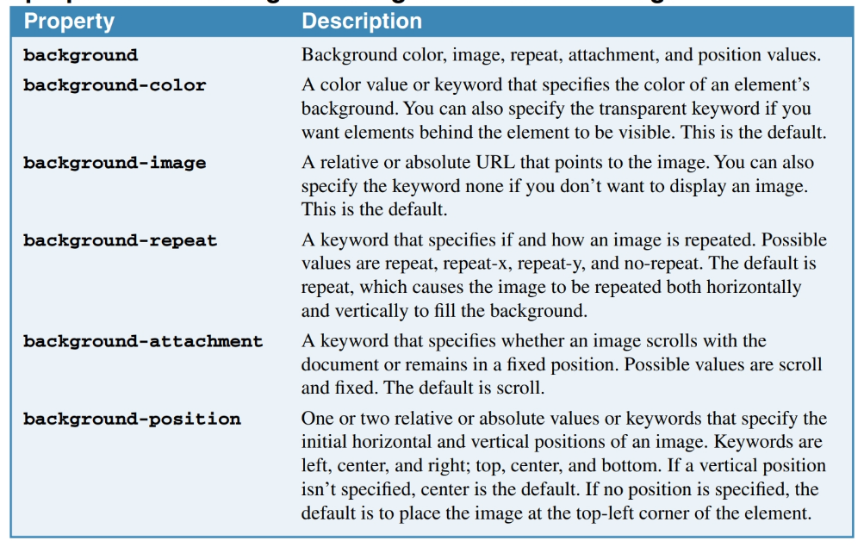
The properties for setting the background color and image
Notes:
https://developer.mozilla.org/en-US/docs/Web/CSS/background
https://developer.mozilla.org/en-US/docs/Web/CSS/background-position
https://developer.mozilla.org/en-US/docs/Web/CSS/background-size
https://developer.mozilla.org/en-US/docs/Web/CSS/background-repeat
https://developer.mozilla.org/en-US/docs/Web/CSS/background-attachment

Slide 28
The properties for setting the background color and image
background
background-color
background-image
background-position
background-size
background-repeat
background-attachment
The syntax for the shorthand background property
background: [color] [image] [position][/size]
[repeat] [attachment];
Notes:
https://developer.mozilla.org/en-US/docs/Web/CSS/background
https://developer.mozilla.org/en-US/docs/Web/CSS/background-position
https://developer.mozilla.org/en-US/docs/Web/CSS/background-size
https://developer.mozilla.org/en-US/docs/Web/CSS/background-repeat
https://developer.mozilla.org/en-US/docs/Web/CSS/background-attachment

Slide 29
How to use the shorthand property
background: blue;
background: blue url("../images/texture.gif");
background: #808080 url("../images/header.jpg")
center/80% repeat-y scroll;
How to set the background color and image with separate properties
background-color: blue;
background-image: url("../images/texture.gif");
Notes:
https://developer.mozilla.org/en-US/docs/Web/CSS/background
https://developer.mozilla.org/en-US/docs/Web/CSS/background-position
https://developer.mozilla.org/en-US/docs/Web/CSS/background-size
https://developer.mozilla.org/en-US/docs/Web/CSS/background-repeat
https://developer.mozilla.org/en-US/docs/Web/CSS/background-attachment

Slide 30
How to control image repetition, position, and scrolling
background-repeat: repeat; /* repeats both directions */
background-repeat: repeat-x; /* repeats horizontally */
background-repeat: repeat-y; /* repeats vertically */
background-repeat: no-repeat; /* doesn't repeat */
background-position: left top; /* 0% from left, 0% from top */
background-position: center top; /* centered horizontally, 0% from top */
background-attachment: scroll; /* image moves as you scroll */
background-attachment: fixed; /* image does not move as you scroll */
Accessibility guideline
Don’t use a background color or image that makes the text that’s over it difficult to read.

Slide 31
How to control image size
/* Scales the image as large as possible
without cropping or stretching the image. */
background-size: contain;
/* Scales the image as large as possible
without stretching the image.
If the proportions of the image differ from the element,
it is cropped either vertically or horizontally
so that no empty space remains */
background-size: cover;
More Information
https://developer.mozilla.org/en-US/docs/Web/CSS/background-size

Slide 32
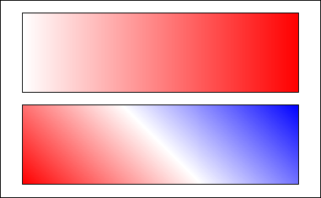
The syntax for using a linear gradient in the background-image property
background-image:
linear-gradient(direction, color %, color %, ... );
The HTML for two divisions
<div id="eg1"></div>
<div id="eg2"></div>
The CSS for the two divisions
#eg1 {
background-image:
linear-gradient(to right, white 0%, red 100%);
}
#eg2 {
background-image:
linear-gradient(45deg, red 0%, white 50%, blue 100%);
}
book_examples/ch05/12_gradients.html

Slide 33

A background-image property that creates hard red, white, and blue stripes
background-image:
linear-gradient( 45deg, red 0%, red 33%, white 33%, white 66%,
blue 66%, blue 100%);
More Information
https://developer.mozilla.org/en-US/docs/Web/CSS/background-image
https://www.w3schools.com/css/css3_gradients.asp
https://caniuse.com/#search=linear-gradient
book_examples/ch05/12_gradients.html

Slide 34

A web page with borders and a gradient
book_apps/ch05/town_hall/index3.html

Slide 35
The CSS for the borders and gradient
html {
background-image: linear-gradient(to bottom, white 0%, #facd8a 100%;
}
body {
background-color: white;
border: 1px solid black;
border-radius: 25px;
box-shadow: 5px 5px 0 0;
}
header {
border-bottom: 2px solid #f2972e;
}
header h2 {
text-shadow: 2px 3px 0 black;
}
footer {
border-top: 2px solid #f2972e;
}
book_apps/ch05/town_hall/index3.html

Slide 36

Short 5-1 Apply CSS to an HTML page

Slide 37
Objectives
Applied
Given an HTML document, create CSS style rules that use the CSS box model to apply spacing, borders, and backgrounds.
Knowledge
Describe the use of the CSS box model.
Explain how the CSS box model can be used to control the spacing between the headings and paragraphs on a page.
Describe the effect of “collapsed margins”.
Describe these properties for a block element in a box model: height, width, margin, padding, border, background color, and background image.
Describe these CSS3 features for formatting boxes: rounded corners, shadows, background gradients.

Slide 38
Assignments
Reading assignments on Perusall
Homework and Labs on InsideRanken

